Slide 1

Year in Review

Slide 2
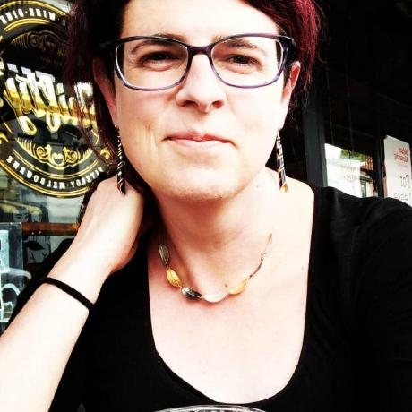
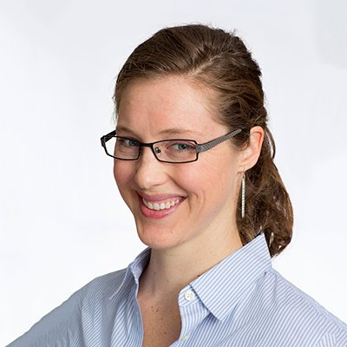
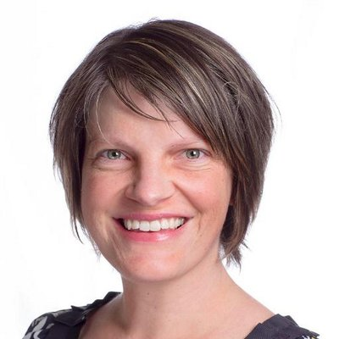
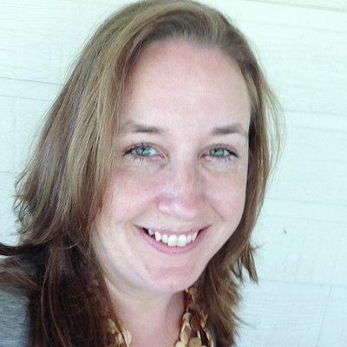
Organising committee
Danielle Navarro
Lisa Williams
Jen Richmond
Steph Stammel

Slide 3
Events
RCurious
Little Miss Tidyverse
Bayesian Inference with Rstan
Shiny September
Machine Learning in R
RMarkdown ThrowHackdown
Data Science Education “Resource Hack Day”
Twitter Analysis in R
Meetup with Hadley Wickham

Slide 4


Ongoing Activities

Slide 5
Upcoming Events
21 Aug.
purr with Rebecca Barter
28 Aug.
Gold Star Reproducibility with Saras Windecker
4 Oct.
Something Awesome with Alison Hill

Slide 6



Stay in touch!
https://www.meetup.com/en-AU/rladies-sydney/
https://rladiessydney.org/
@rladiessydney

